Slide 1
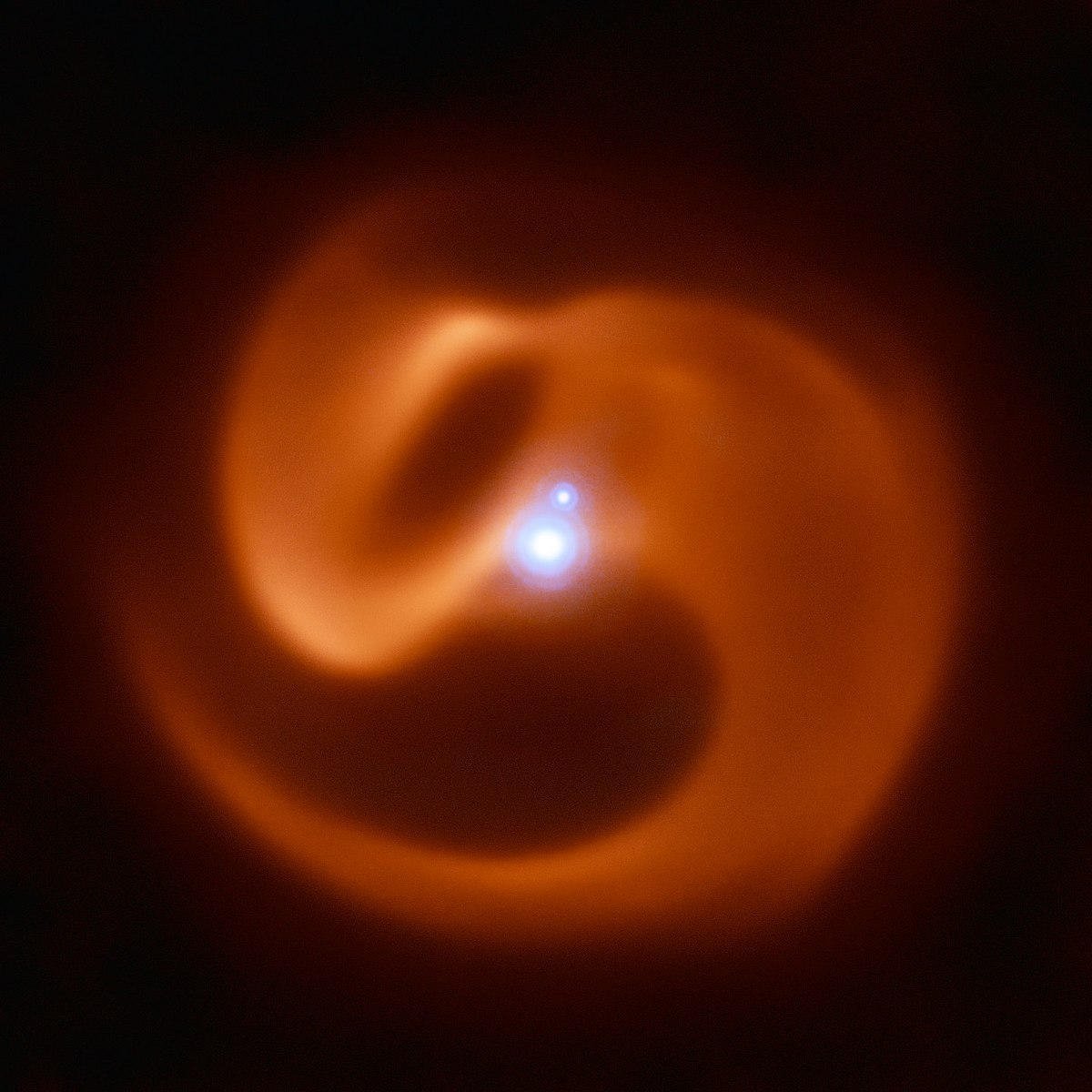
The Serpent Eating Its Own Tail
How strange geometry reveals some of the nastiest stellar interactions in the Galaxy
Ryan White, Macquarie University for SPRIGS August 08

Slide 2
Colliding Wind Binaries
Are the dominant influences on their environment,
made up a large part of the Universe’s early carbon content,
allow us to peer into binary stellar evolution and the evolution of massive stars,
and just look unreasonably cool.
Apep with ESO’s VLT

Slide 3
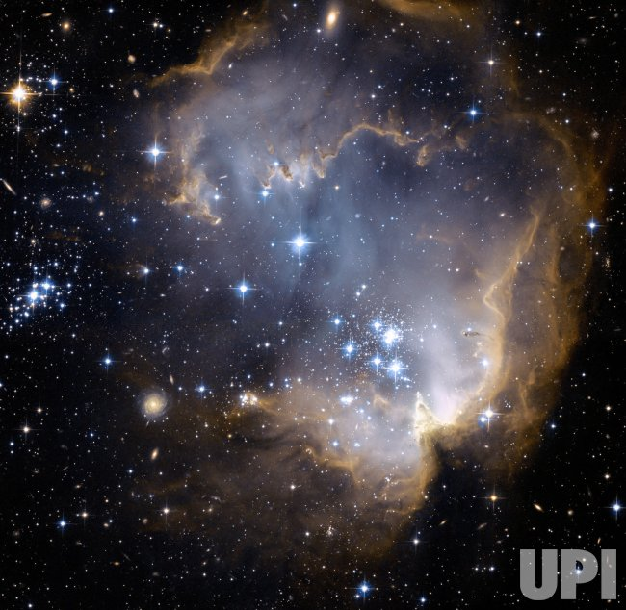
























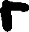

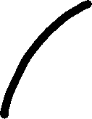
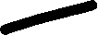
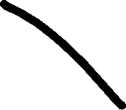




























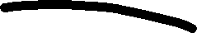








A broad overview of massive stellar evolution
Neutron Star
OB Star
Red Supergiant
Then spends the majority of its life on the main-sequence burning hydrogen into heavier elements
Blue Supergiant
Supernova
Our massive star is
born from the collapse
of a molecular cloud
Wolf-Rayet Star
Black Hole

Slide 4
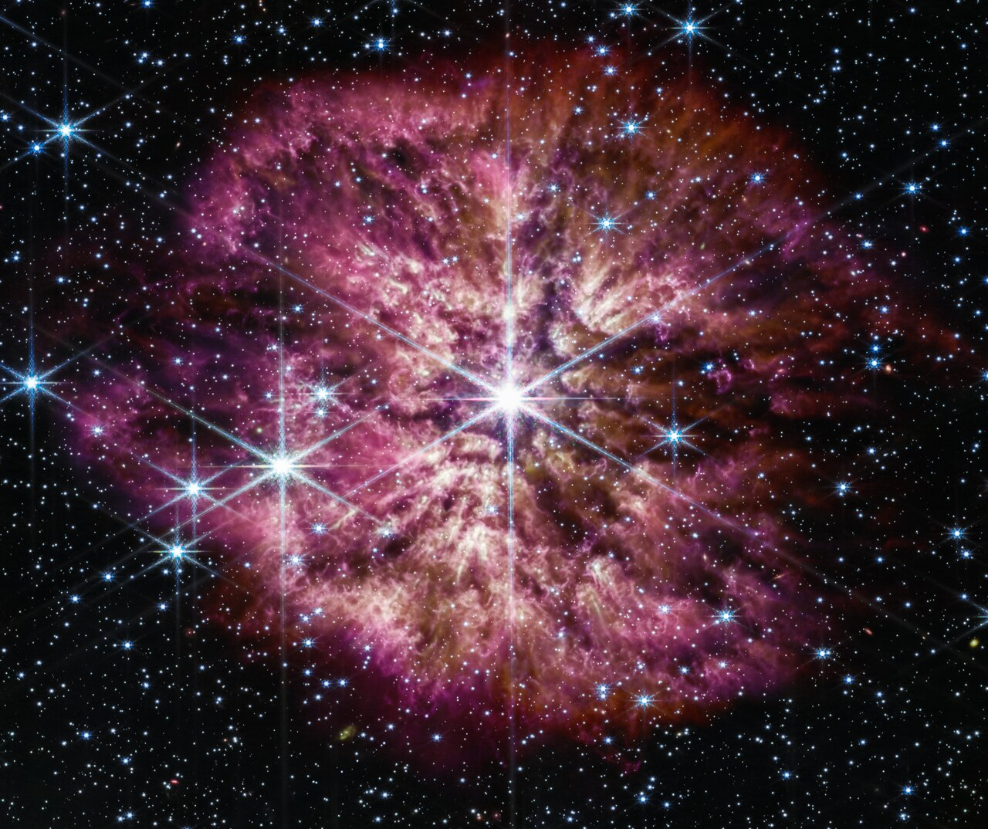
Wolf-Rayet stars
End-of-life phase of the most massive stars
Very short lived and rare
Extremely high mass loss rates and fast winds
~10⁻⁵-10⁻⁴ M⊙/yr
500-3000 km/s
SNe Ib/c progenitors
WR 124 with NASA/ESA’s JWST

Slide 5
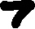












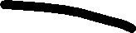
















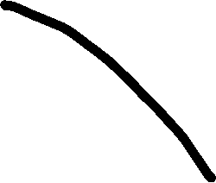











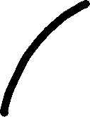







A broad overview of massive stellar evolution
binary
O+OB Stars
Mass Transfer
First SN
Stellar
Merger
Final Product
Second SN
Our massive stars are
born from the collapse
of a molecular cloud

Slide 6










































































Wolf-Rayet Colliding Wind Binaries
Wind Mixing Region
WR Star
OB Star
Wind-Wind Shock
OB Wind Region
WR Wind Region
Wind Mixing Region

Slide 7
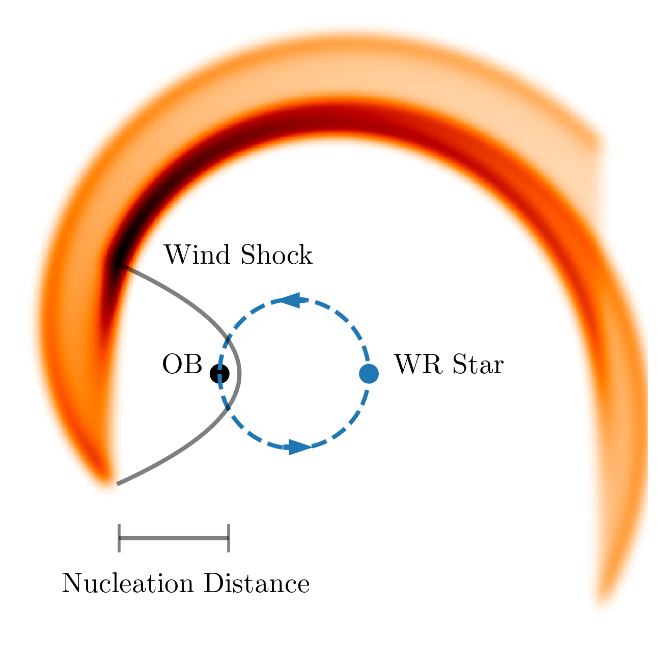
Wolf-Rayet Colliding Wind Binaries
Intense dust formation takes place in systems with WC stars
Forms in a hollow cone tracing the shocked wind
This occurs far enough ‘downstream’ of the shock once the wind is mixed and cooled
The dust expands away from the stars
The orbital motion of the binary wraps this dust into a spiral

Slide 8
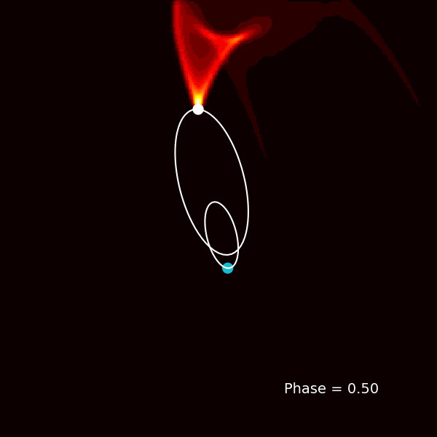
Wolf-Rayet Colliding Wind Binaries

Slide 9
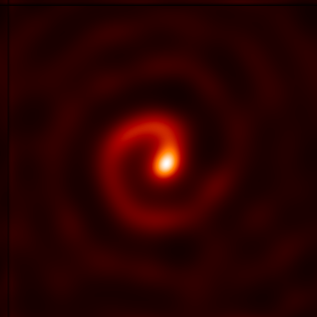
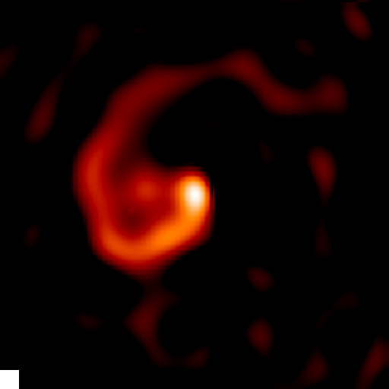
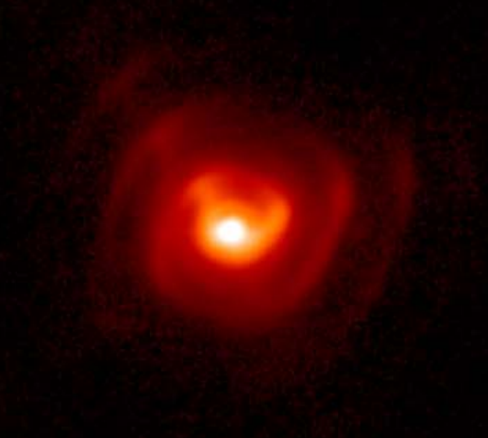
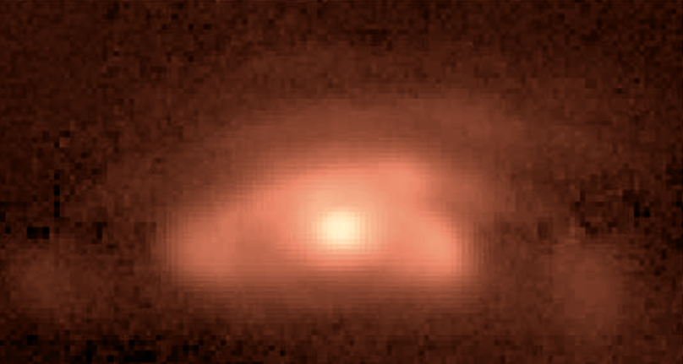
Wolf-Rayet Colliding Wind Binaries
WR 104/Keck
WR 98a/Keck
WR 112/Subaru
WR 48a/Gemini

Slide 10
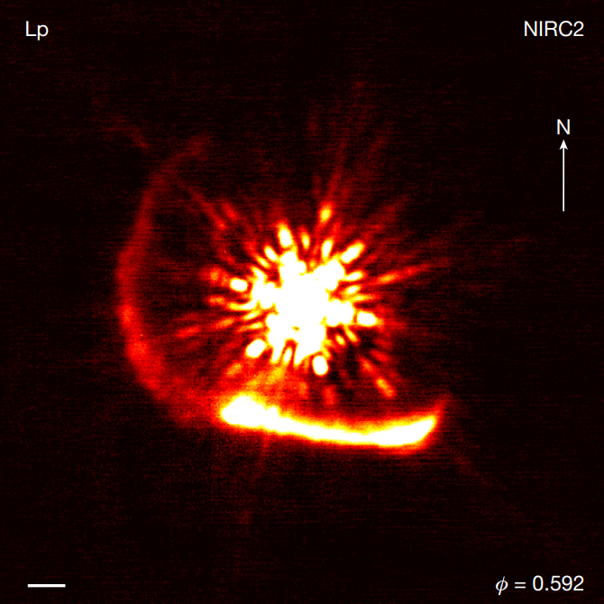
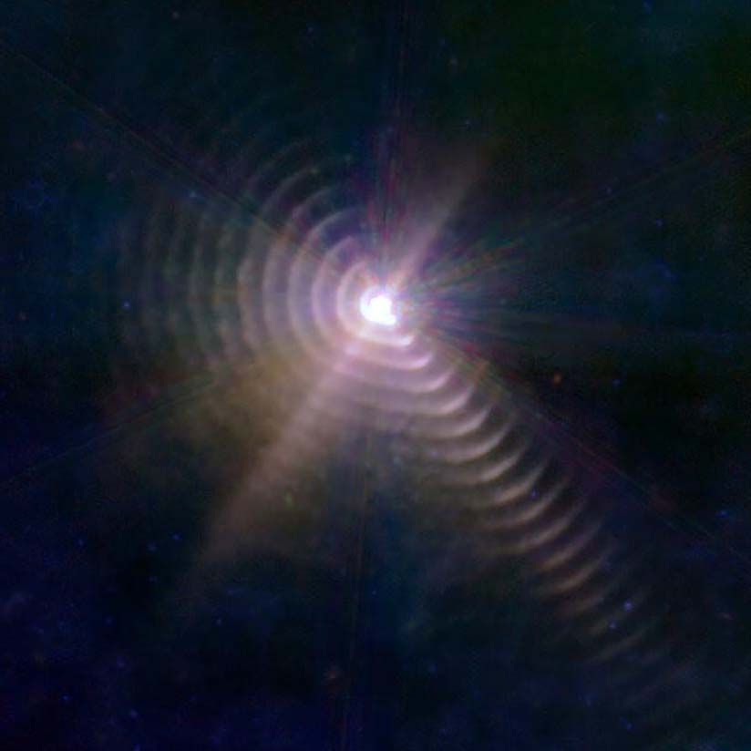
WR 140
WR 140/Keck
WR 140/JWST

Slide 11
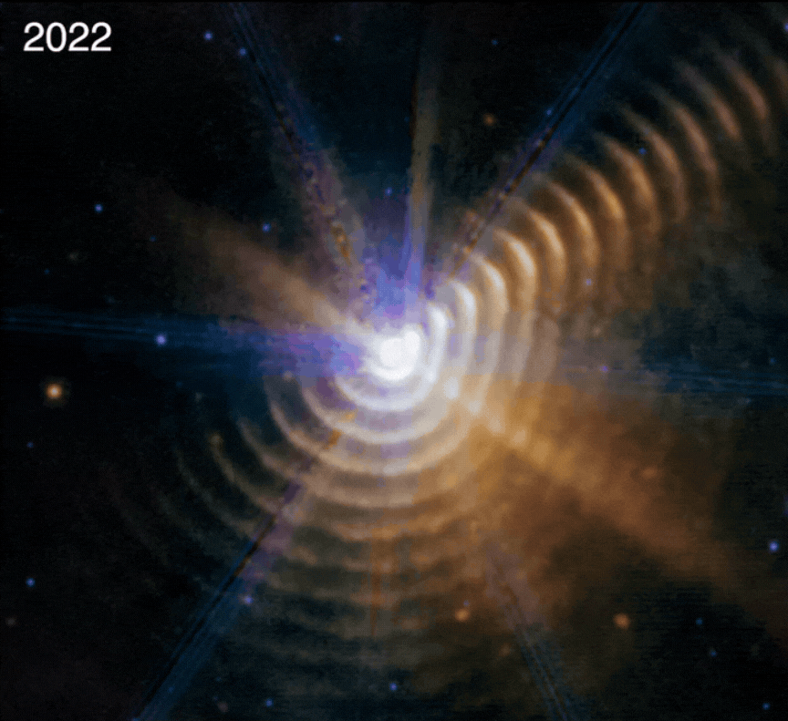
WR 140
WR 140/JWST, Lieb et al 2025

Slide 12
Apep
The only dusty WR+WR CWB
The longest period dusty CWB
Could harbour a LGRB progenitor
Potentially a tertiary O supergiant, making the system a hierarchical triple
One of the brightest stellar non-thermal sources in the Galaxy
Apep with ESO’s VLT

Slide 13
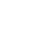


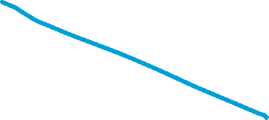

Apep
O Star
WC Star
WN Star
Apep with ESO’s VLT

Slide 14
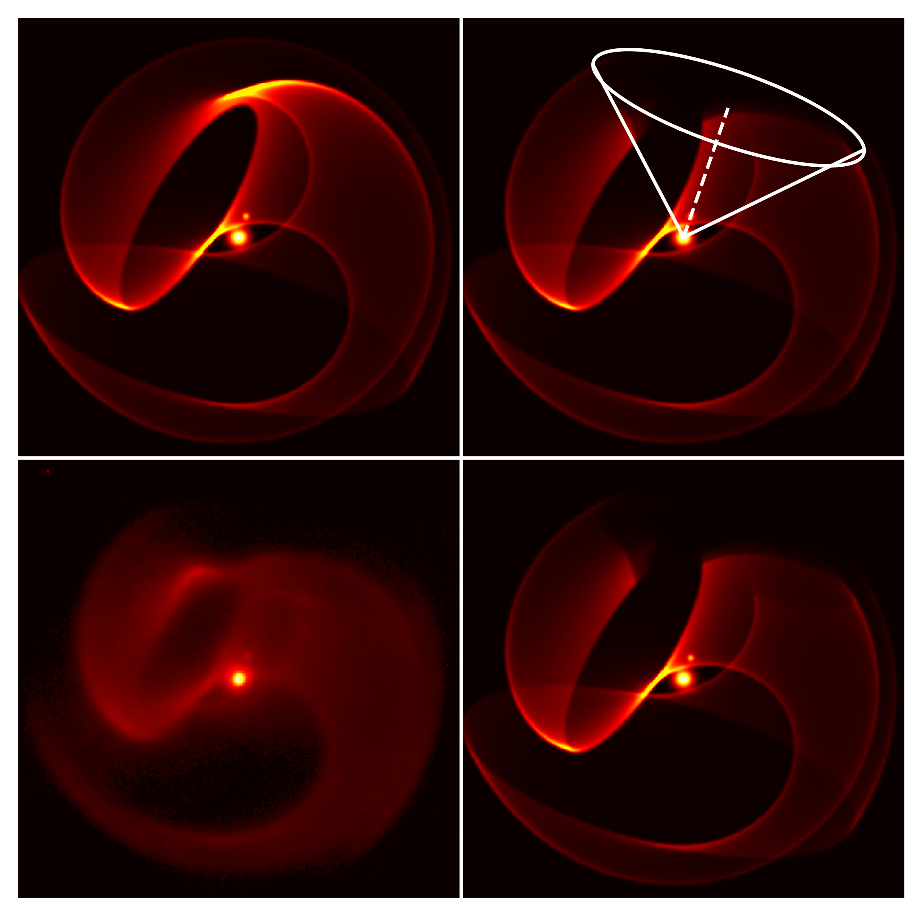
Apep
Standard Apep Model
VLT Image

Slide 15






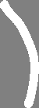







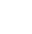




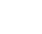











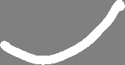











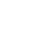

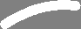










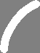

Apep

Slide 16
Apep
Standard Apep Model
Tertiary Shock Geometry
Apep Model incl. Tertiary Shock
VLT Image

Slide 17
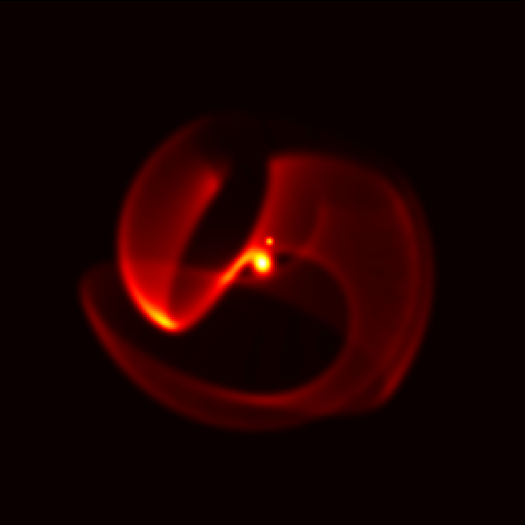
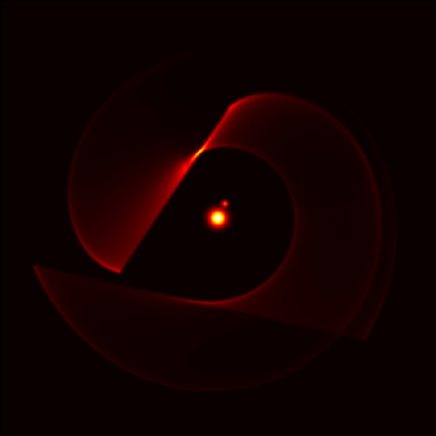
Apep

Slide 18
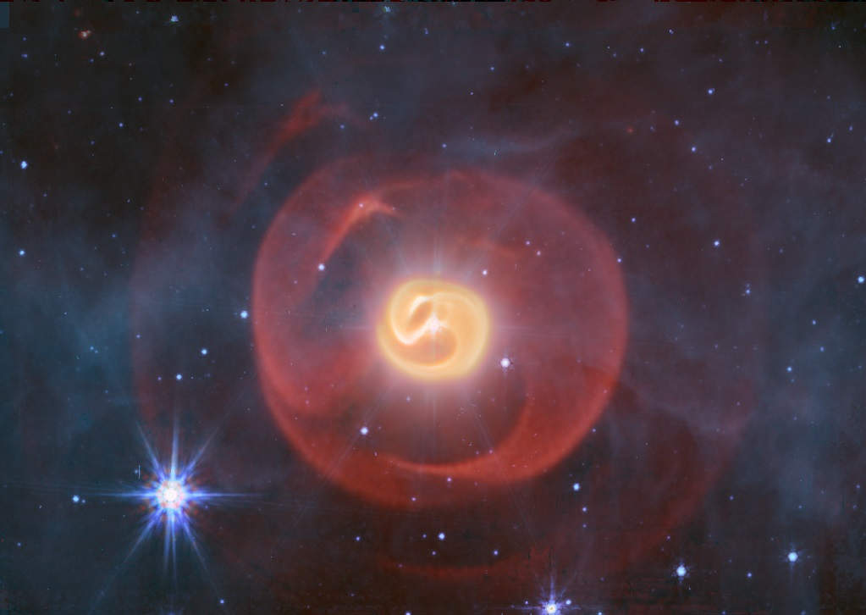

Slide 20
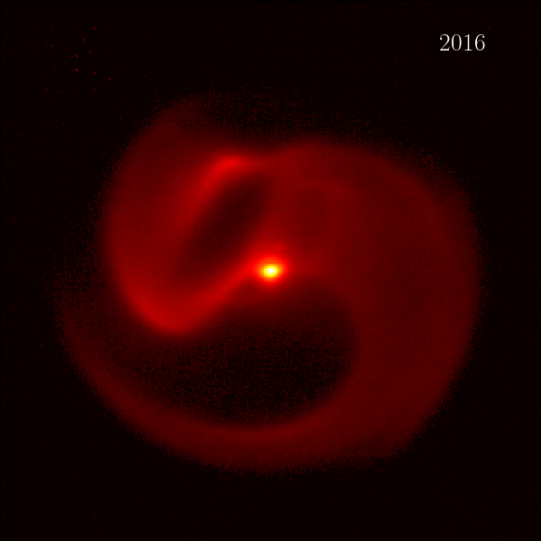
5”

Slide 21
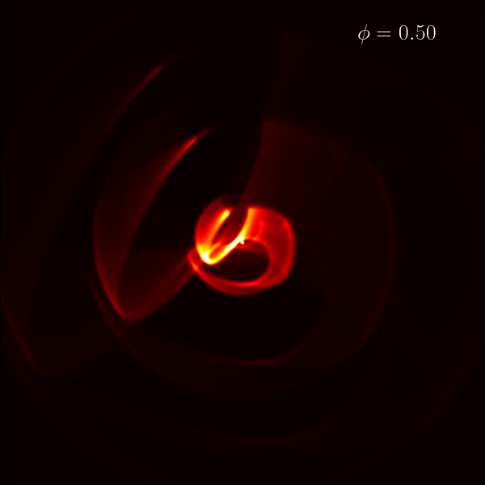
Apep

Slide 22
Apep
WR+WR orbital period is ~193 years
About 6x longer than the next longest period dusty CWB
A confirmed hierarchical triple
The orbit of the inner WR+WR binary has certainly been affected by the O star
The tertiary shock hasn’t been detected in radio up to 40μJy

Slide 23
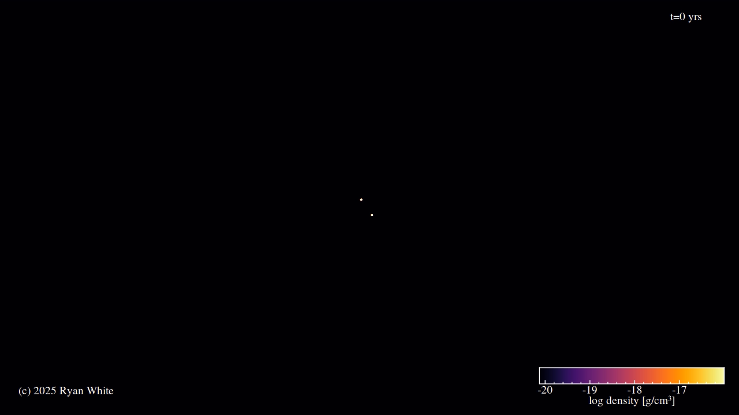
Apep

Slide 24
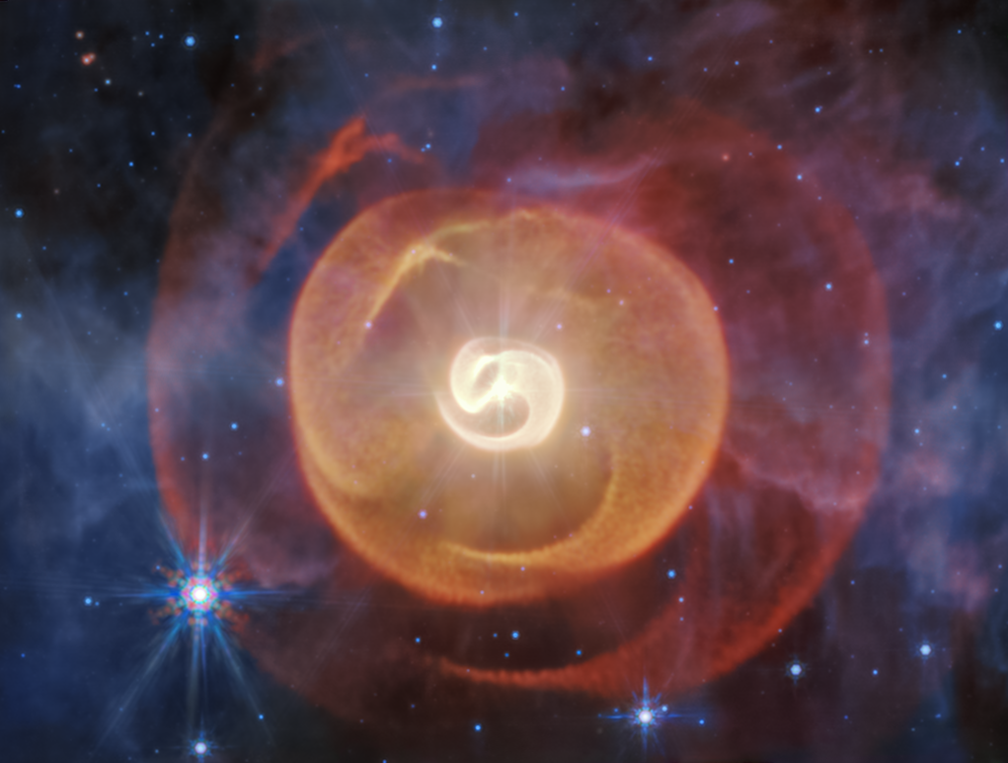

In summary…
arXiv:2412.12534
The dust cavity in the Apep nebula confirms a hierarchical triple
Apep is highly eccentric, and with a very long orbital period
Still plenty of questions left to answer.
Check out our paper!
arXiv:2507.14610 (Submitted to ApJ)

Slide 25
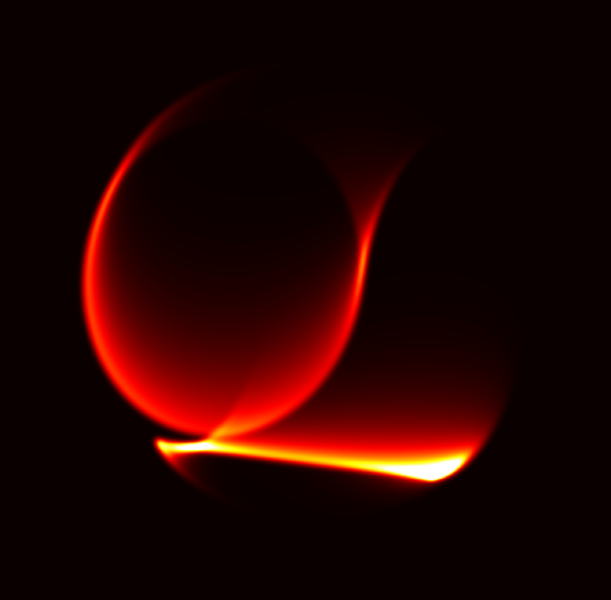
WR 140 – episodic dust producer
WR 140/Keck, Han et al 2022

Slide 26
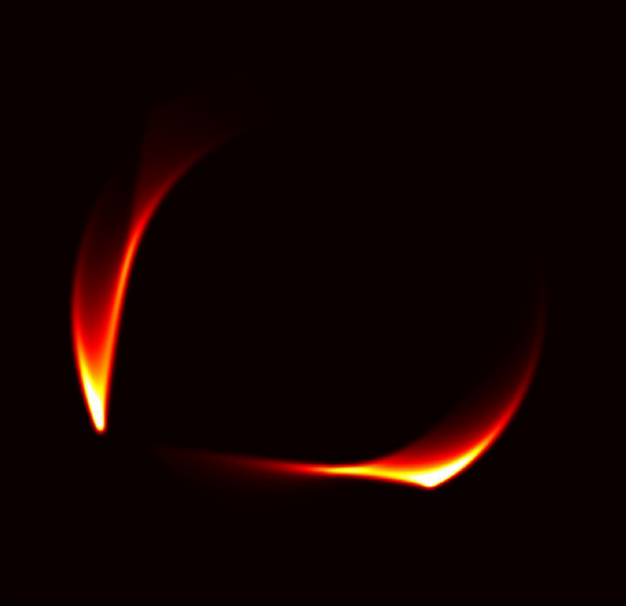
WR 140 – episodic dust producer
WR Orbit
O Star Orbit
Observer view
Top-down view
Han et al 2022

Slide 27

WR 140 – episodic dust producer
WR Orbit
O Star Orbit
Dust Production
Top-down view
Han et al 2022

Slide 28
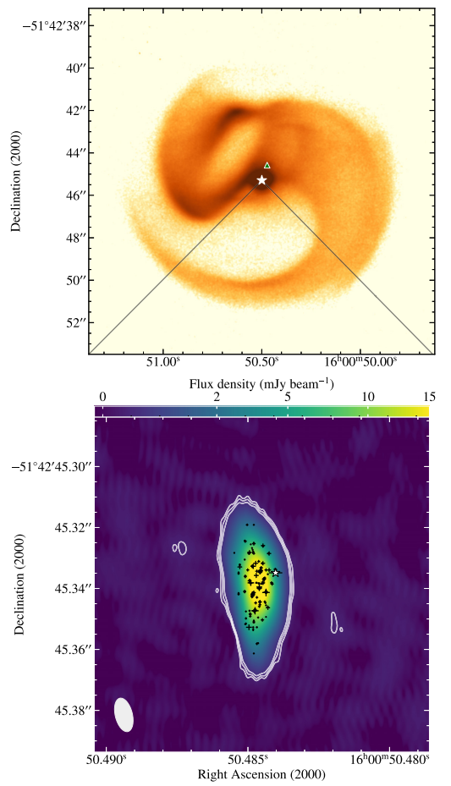
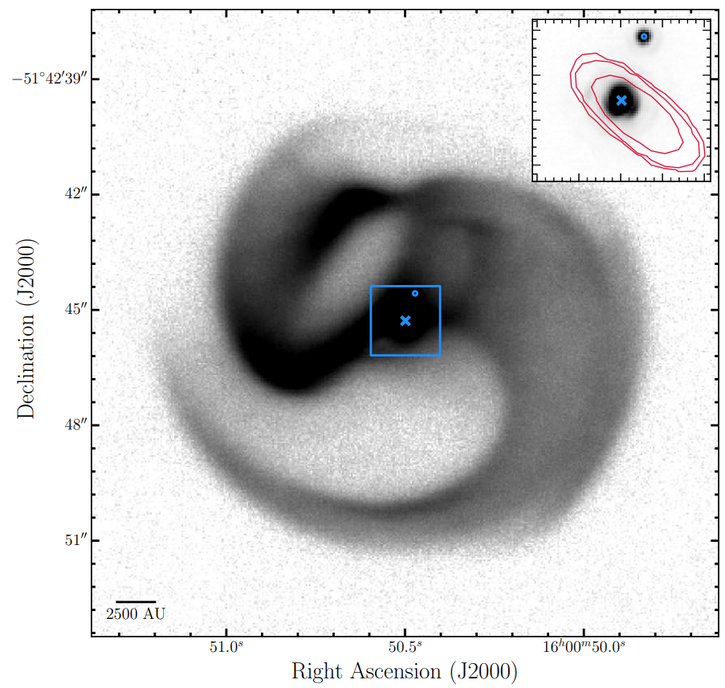
Apep’s tertiary shock
“Additionally, the lack of compact radio emission outside the WCR
(above the rms noise level of 40 μJy) also implies that no significant
interaction occurs between the central binary and the northern O-type supergiant.”
Callingham+2019
Marcote+2021

Slide 29
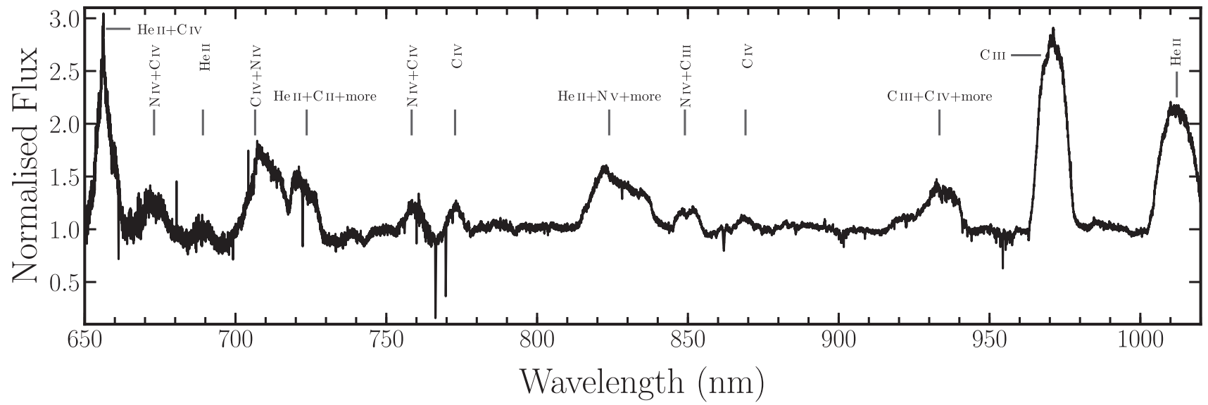
Apep’s wind anisotropy

Slide 30
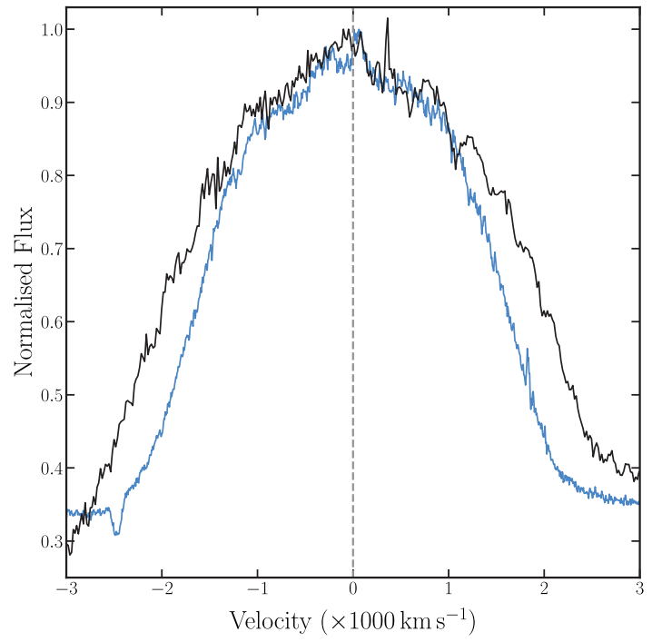
Apep’s wind anisotropy

Slide 31

Apep’s wind anisotropy
2100 + 3500km/s winds
~1020km/s nebular expansion

Slide 32






































Apep’s wind anisotropy
Observer
Rapid rotation leads to a fast and sparse wind at the poles, and a slow and dense wind at the equator
We can observe a fast spectroscopic wind simultaneous with a slow nebula expansion
Wind Contributing to Dust Nebula

Slide 33
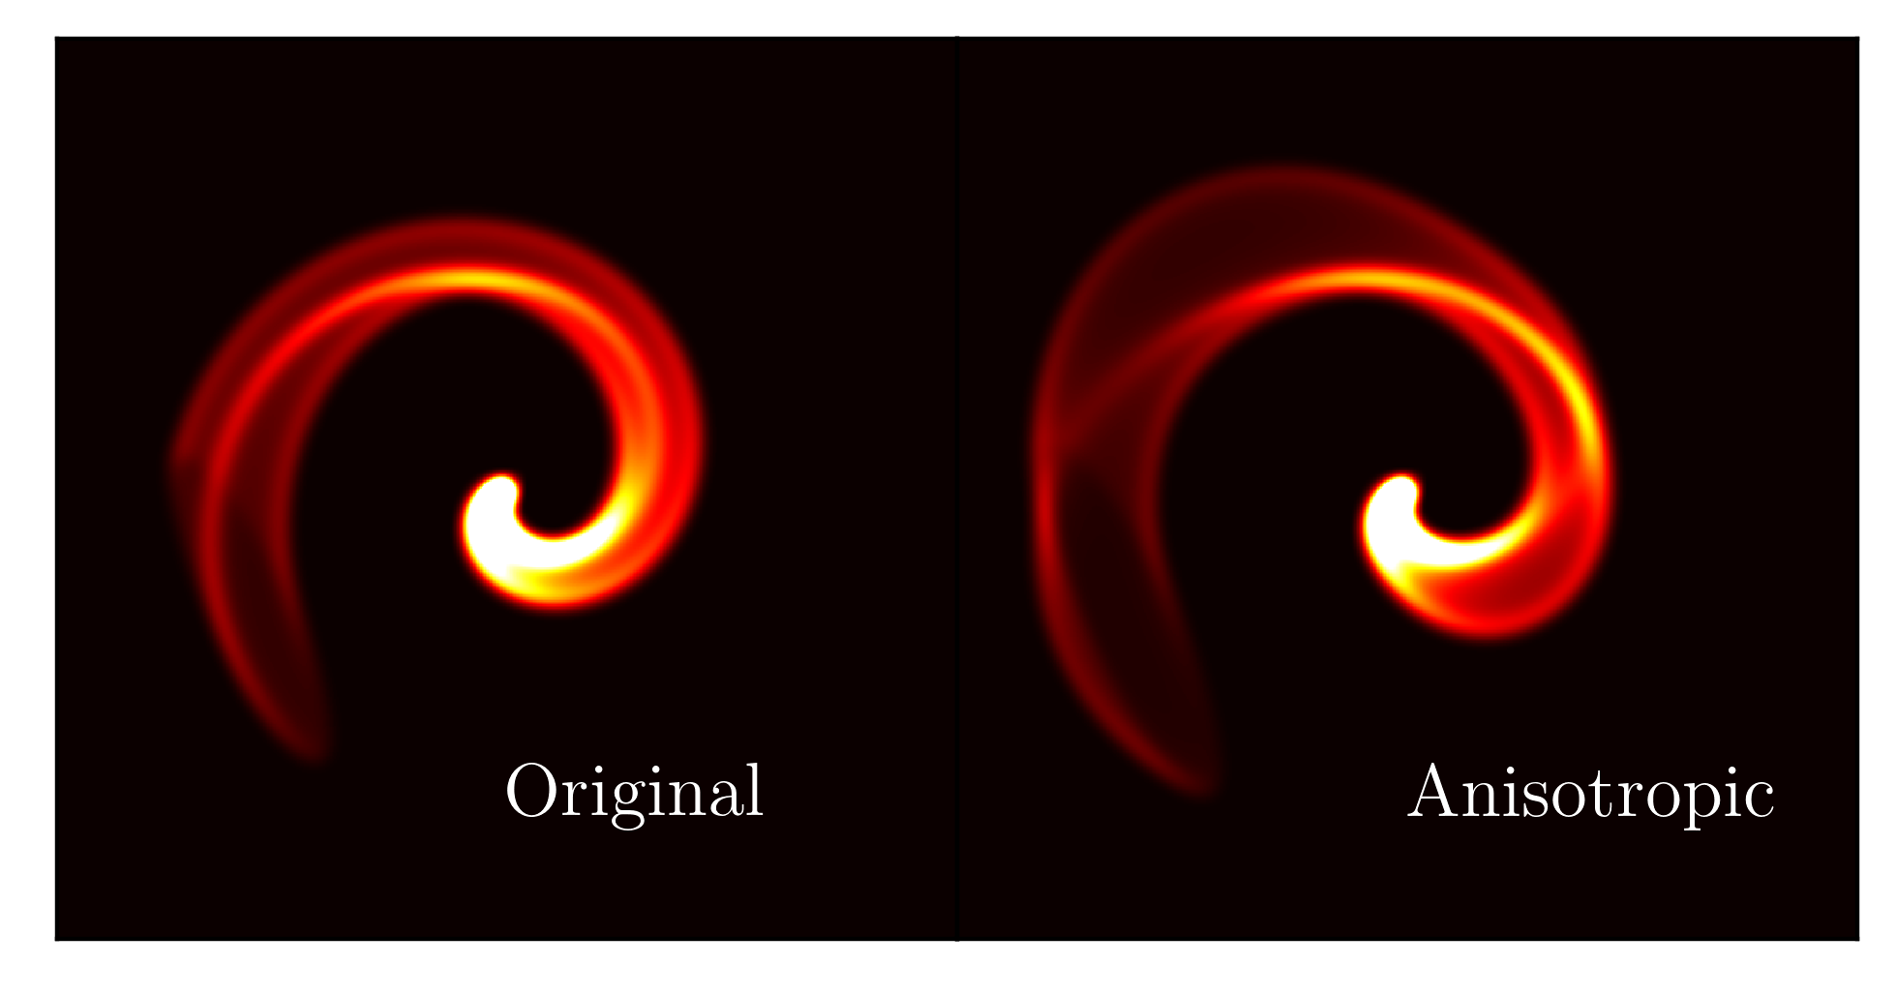
Apep’s wind anisotropy
We emulate anisotropy by changing open angle and expansion speed as a function of true anomaly
This is only relevant when the spin and orbit are misaligned

Slide 34
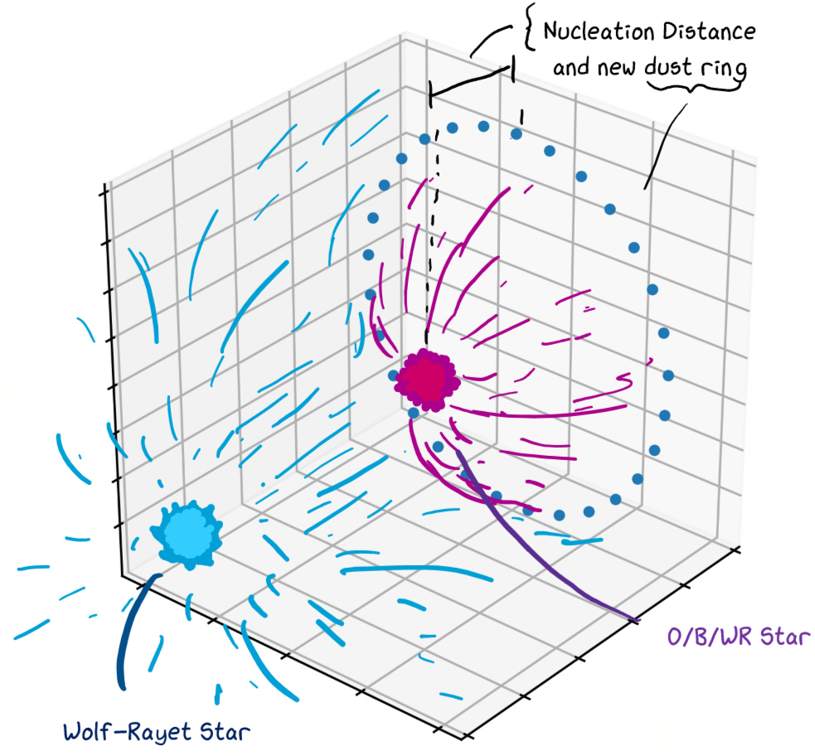
Modelling using geometry
Model the orbits of the two stars
The wind-wind shock enshrouds the star with the weaker wind
Dust nucleation occurs on the surface of the conical shock
At each point in time, we approximate this dust nucleation as a ring of particles on the surface

Slide 35
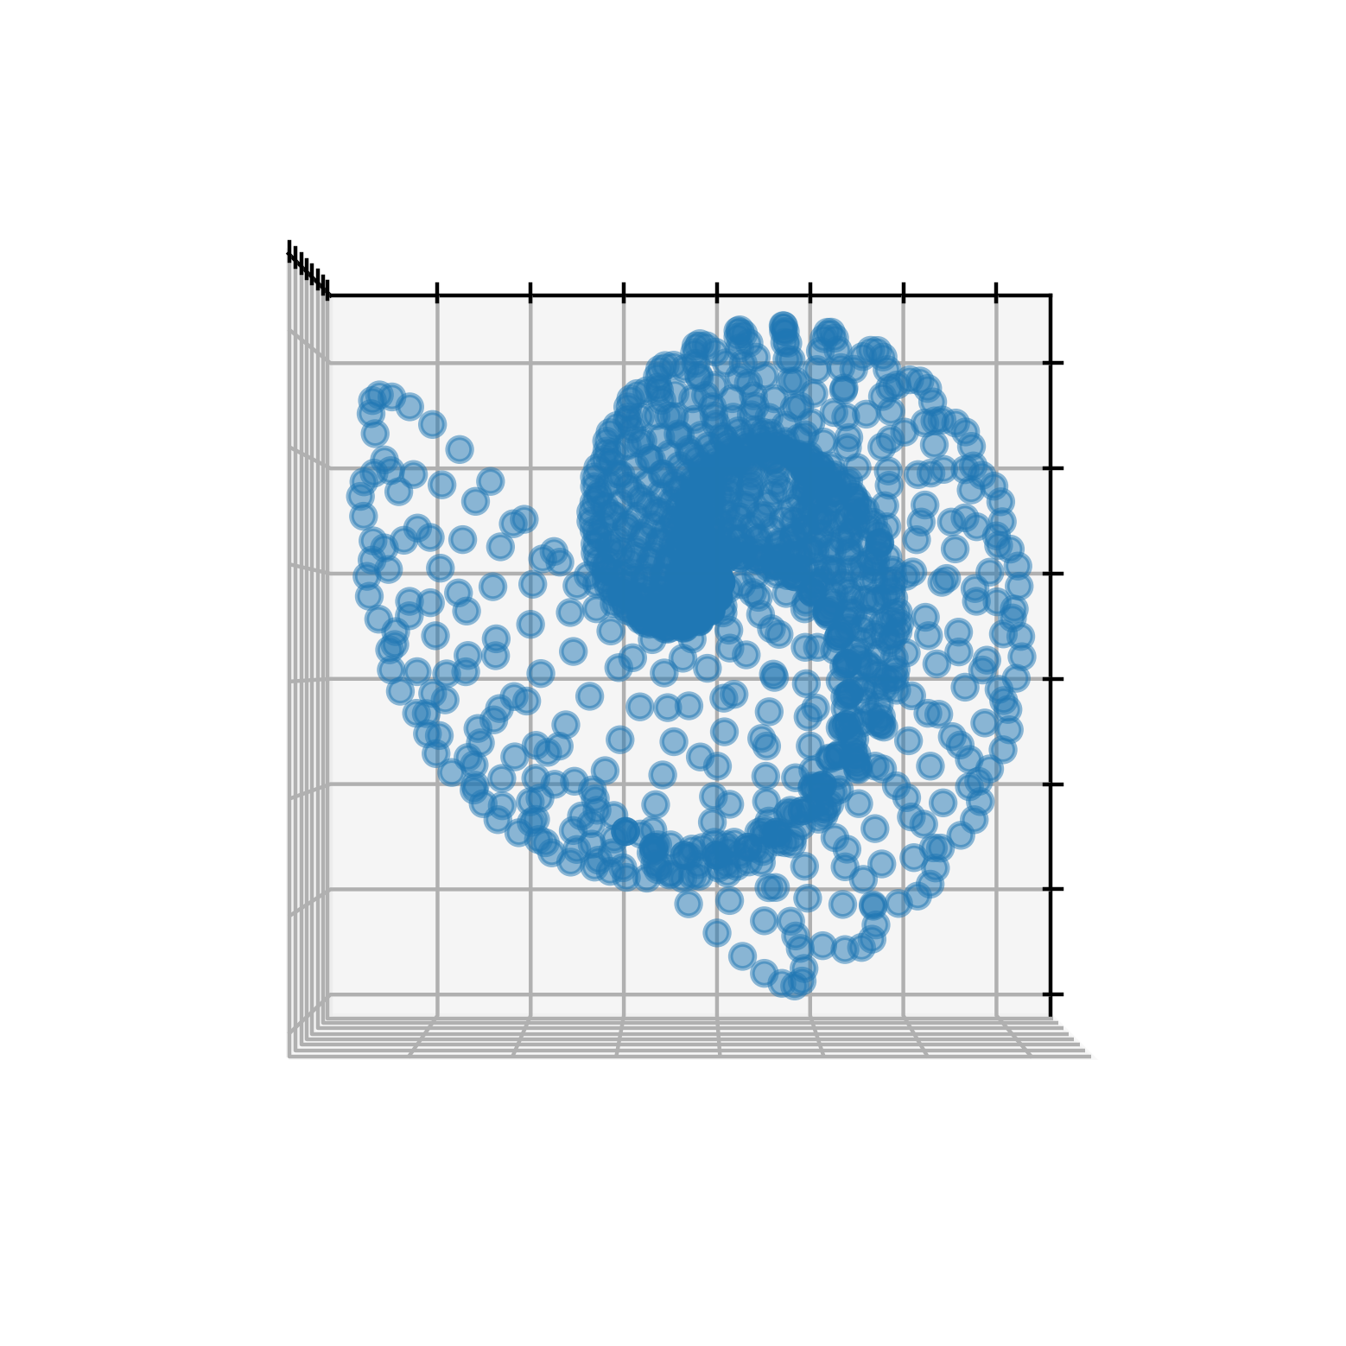
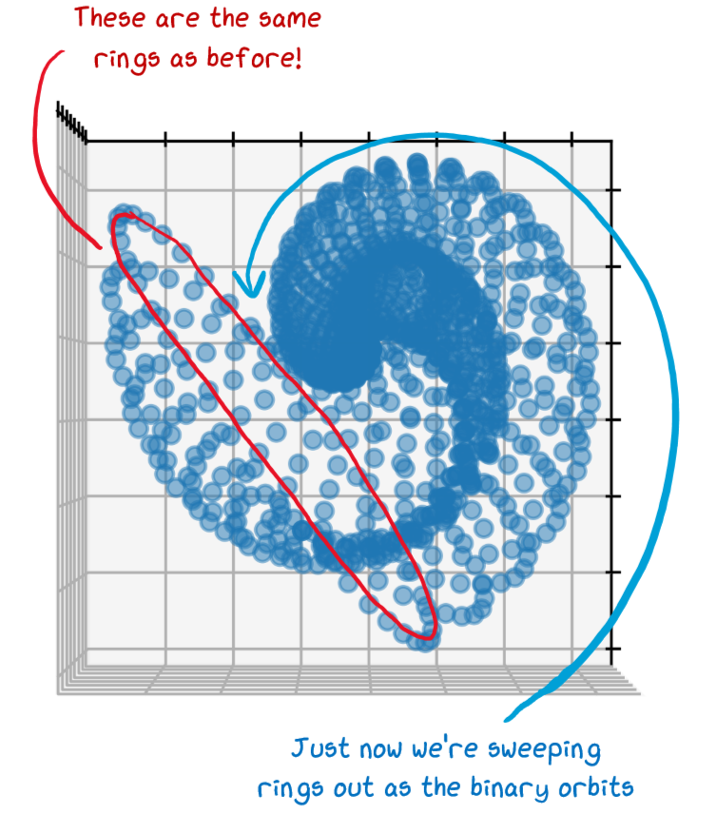
Modelling using geometry

Slide 36
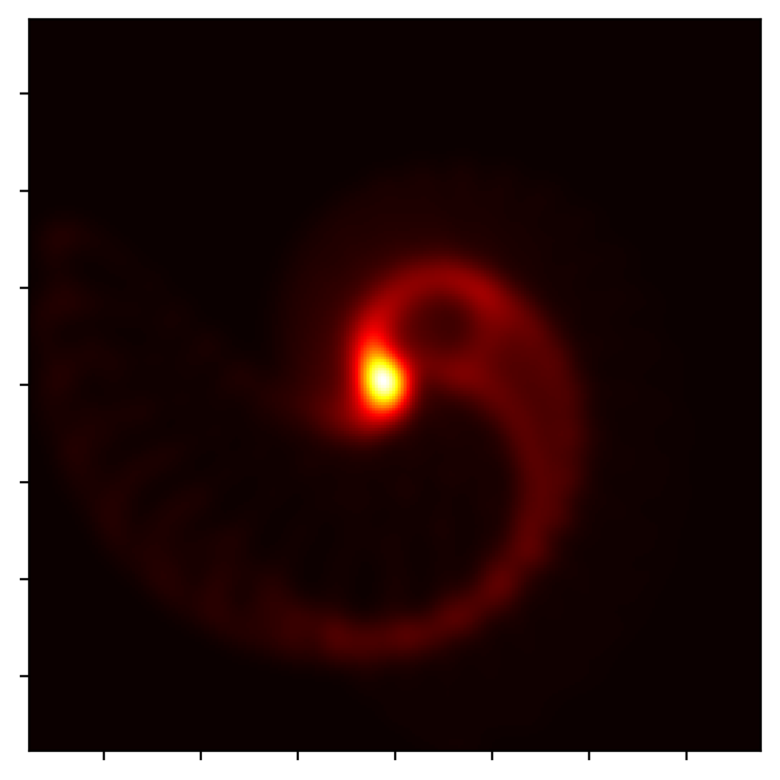

Modelling using geometry

Slide 37
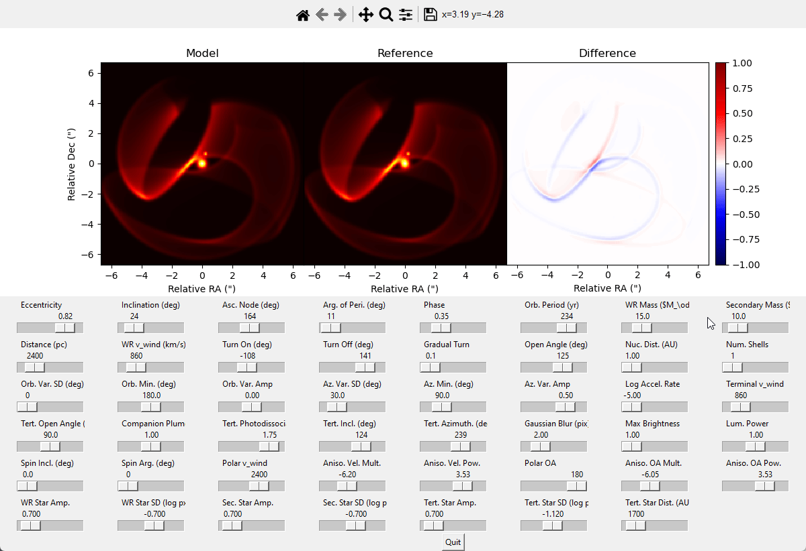
xenomorph – Our new geometric code

Slide 38

xenomorph – Our new geometric code

Slide 39

xenomorph – Our new geometric code
WR 140 from xenomorph
WR 140 from Williams et al (2009)
We can (roughly) model the infrared light curves of CWBs by looking at the brightest pixels over time
More work needed here
E.g. radiative transfer

Slide 40


xenomorph – Our new geometric code
WR 48a with xenomorph
WR 48a from Williams et al (2012)

